Slide 1
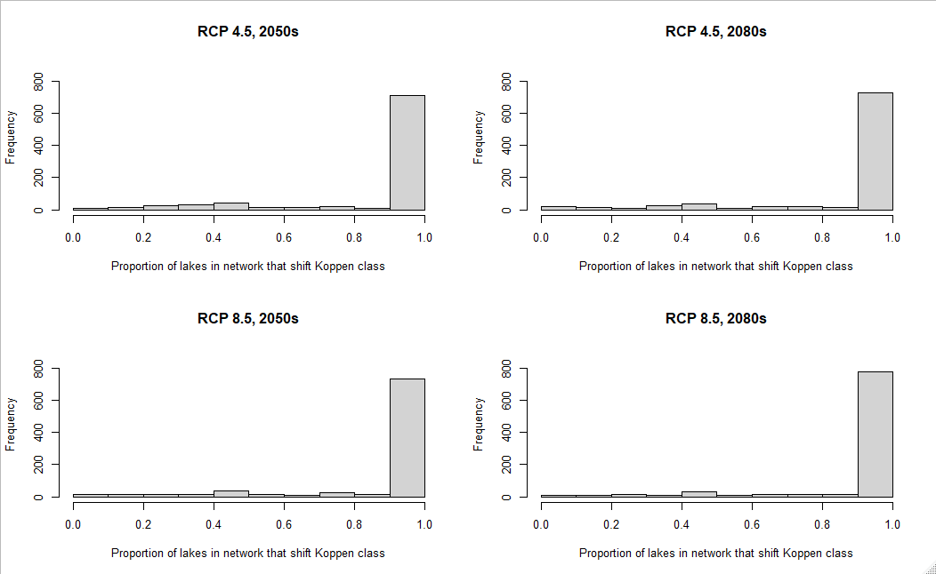
Most networks have most lakes shifting climate, but few networks relatively stable
Shifted climate within network
Stable climate within network

Slide 2
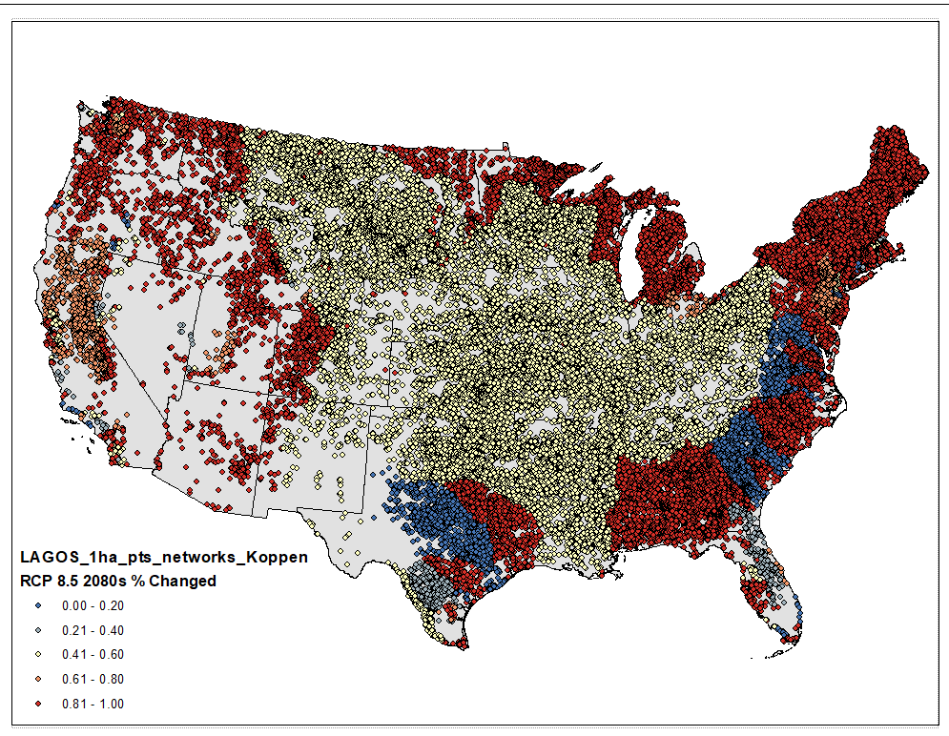
Proportion of lakes in each network that shifted Koppen climate class from 1981-2010 to 2071-2100 under RCP 8.5 (business as usual emissions)

Slide 3
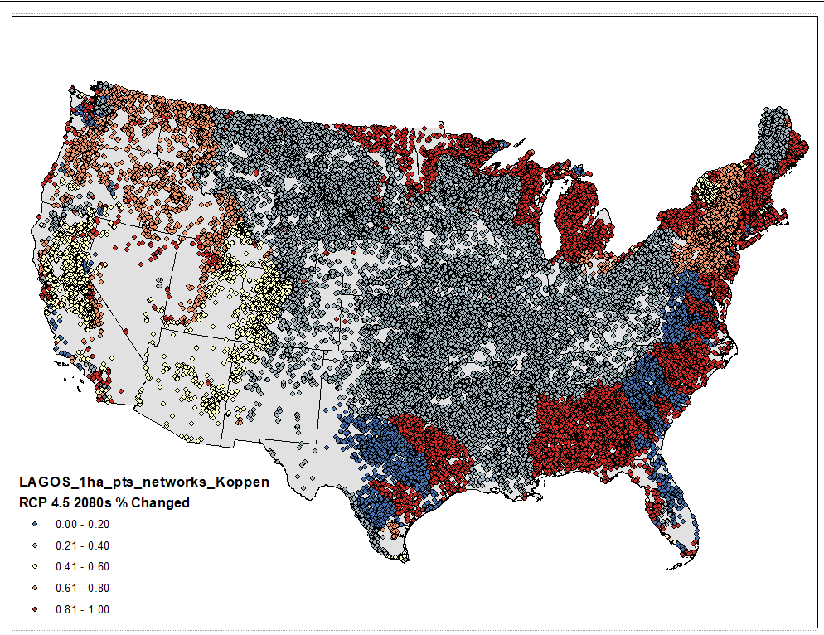
Proportion of lakes in each network that shifted Koppen climate class from 1981-2010 to 2071-2100 under RCP 4.5 (mitigated emissions)

Slide 4
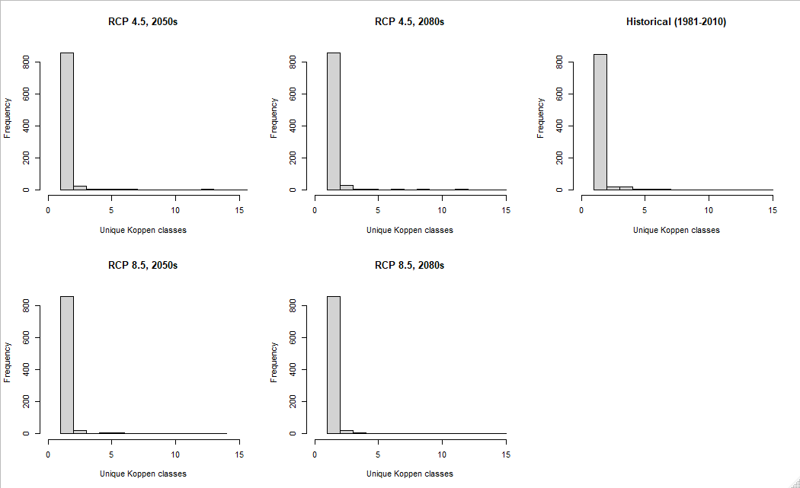
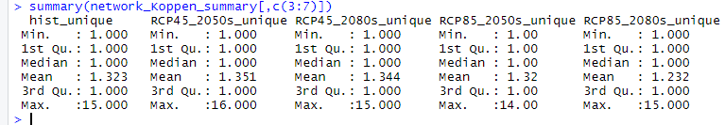
Perhaps slight loss of climatic diversity within networks, but most networks have low climatic diversity

Slide 5
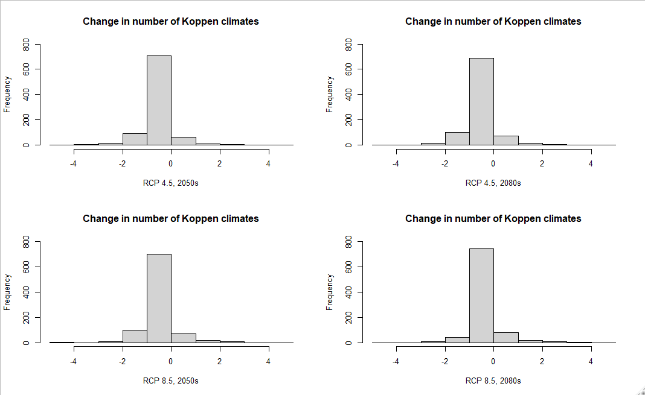
Most networks lost one climate class

Slide 6
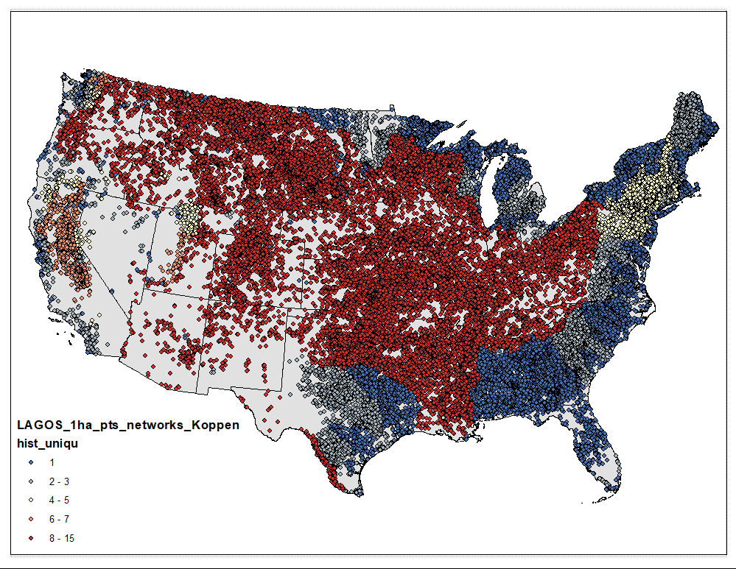
Number of unique Koppen climates in each network for historical period (1981-2010)

Slide 7

Number of unique Koppen climates in each network for RCP 8.5 2071-2100 (business as usual emissions)

Slide 8

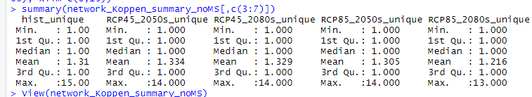
If remove MS river basin
Networks 2, 34, 52 highly diverse climatically

Slide 9
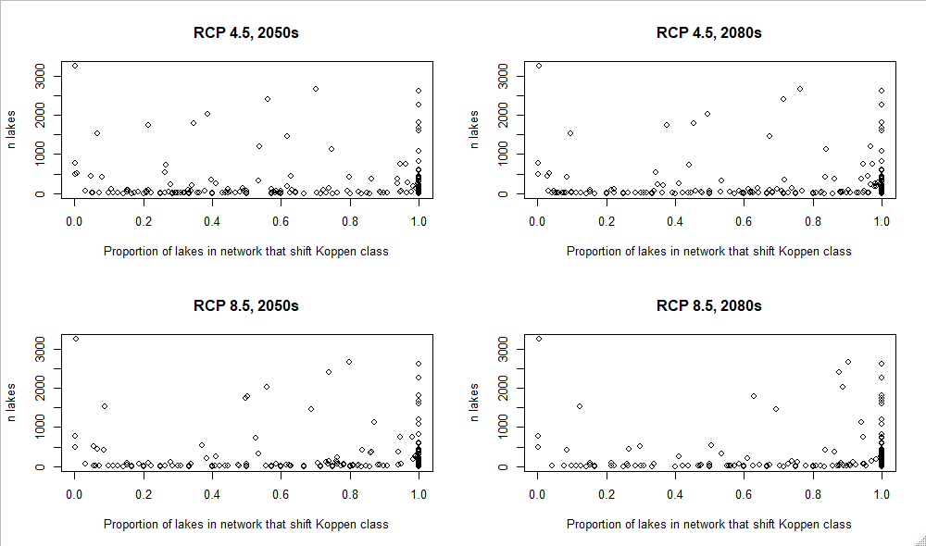
If remove MS river basin
Do networks with more lakes have more/less stable climate?

Slide 10
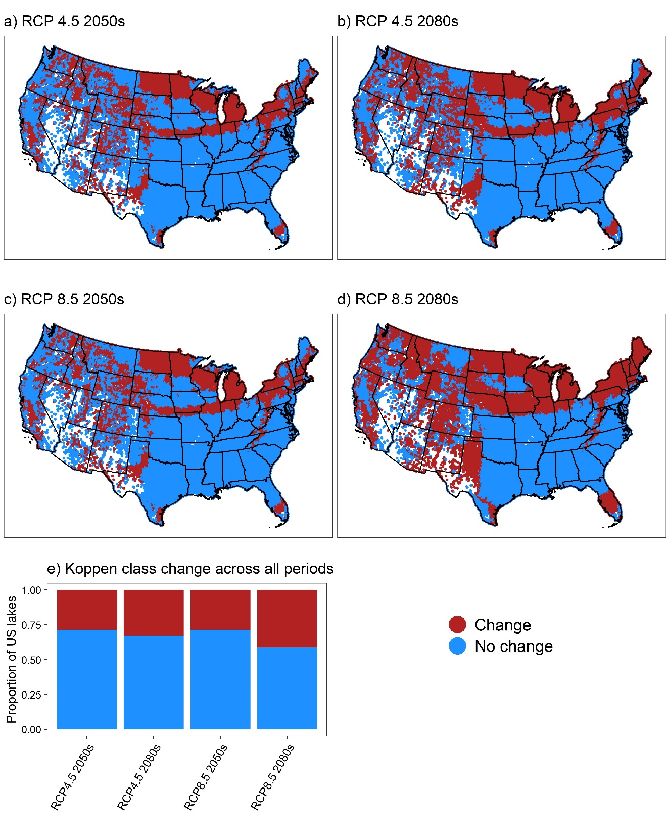
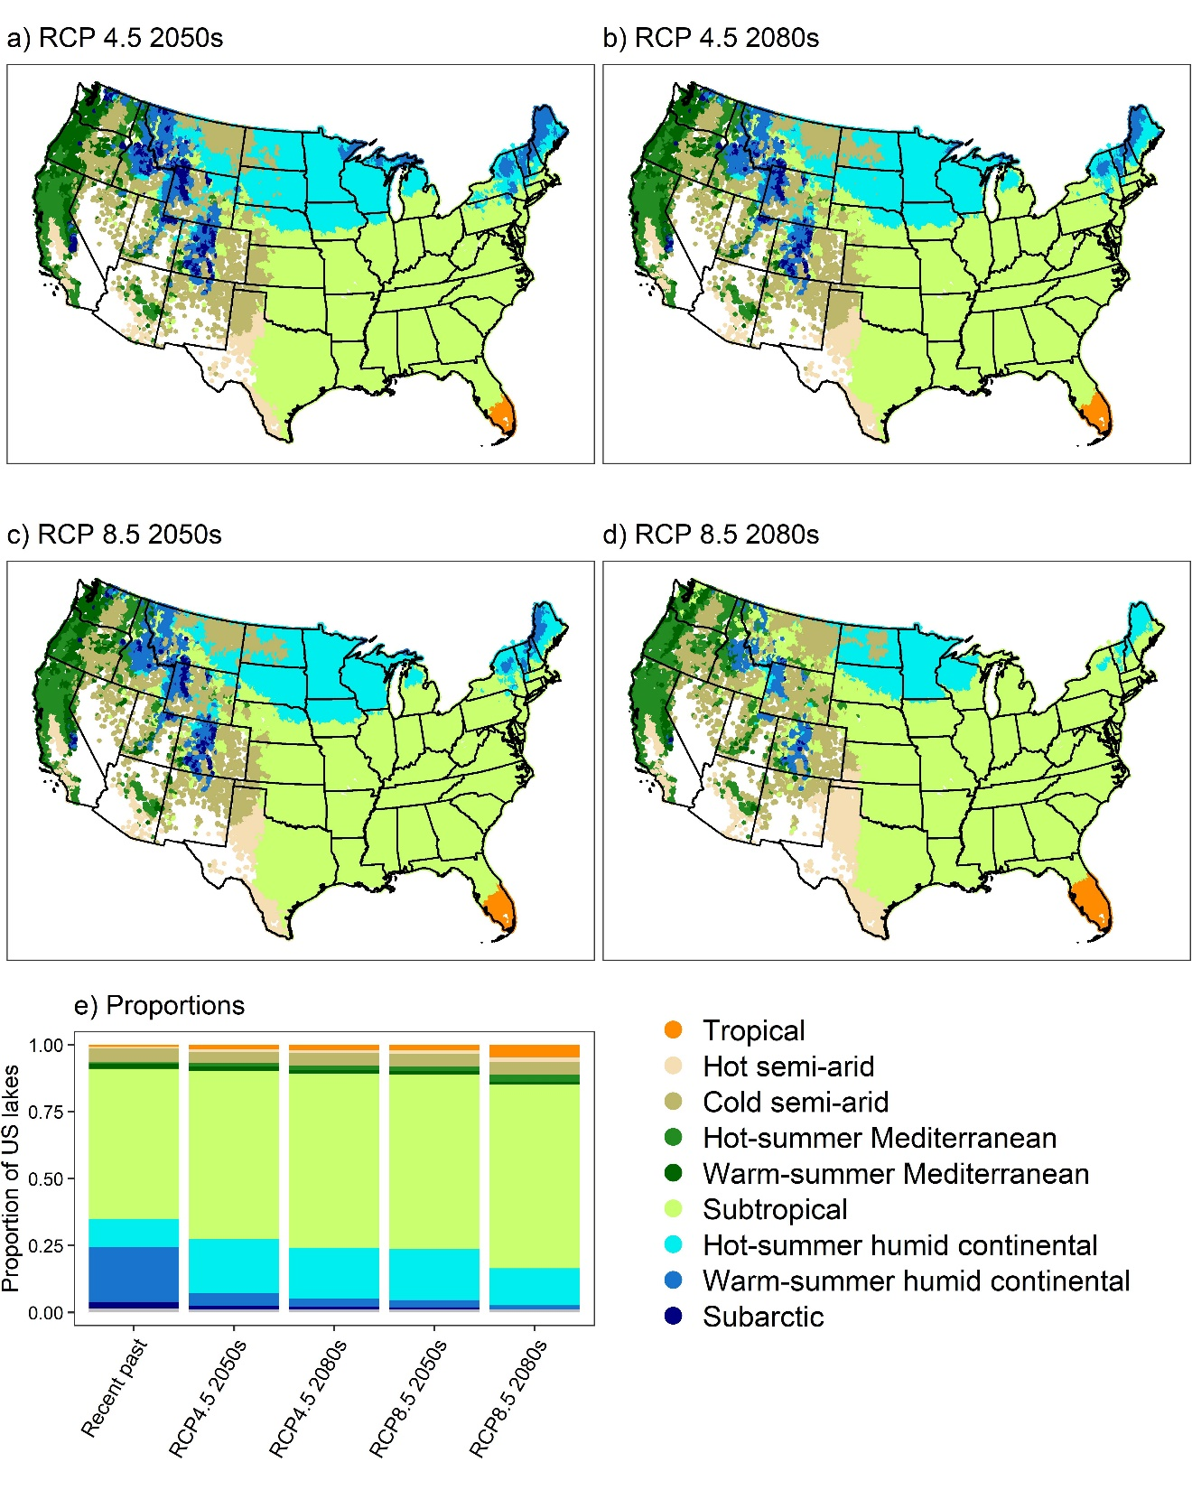

Slide 11
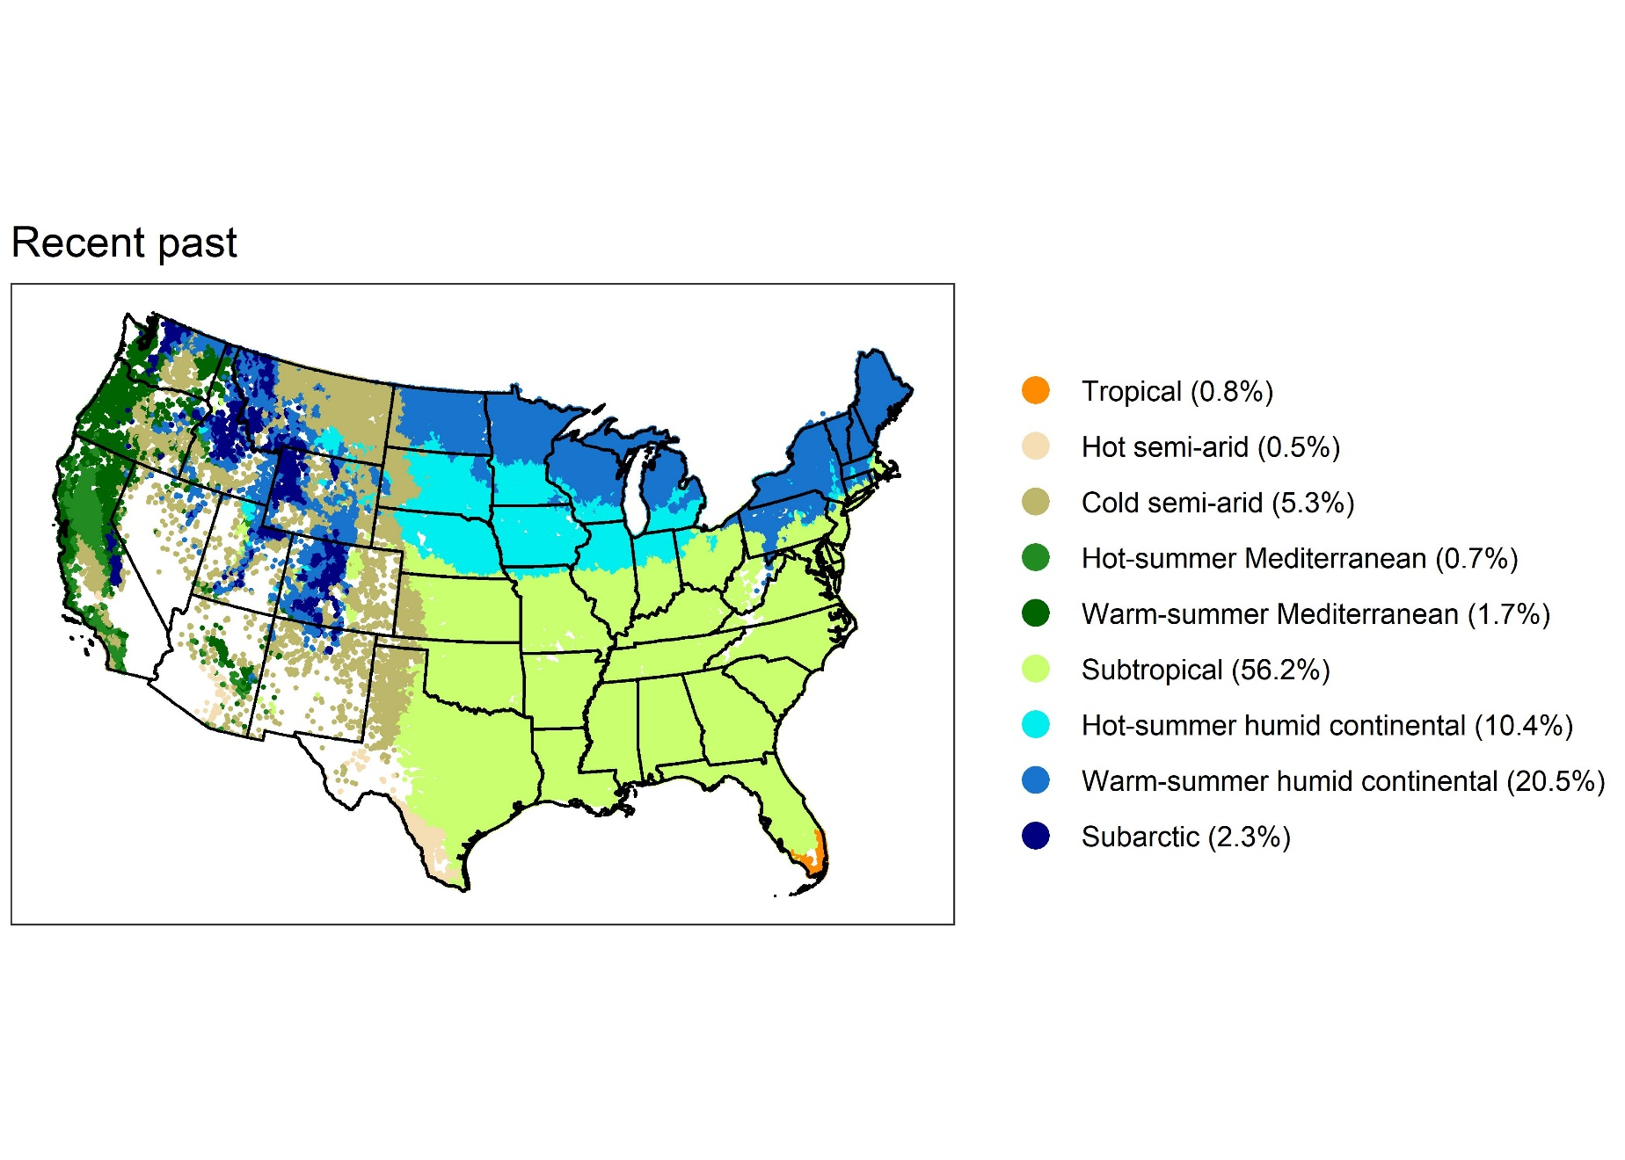

Slide 12
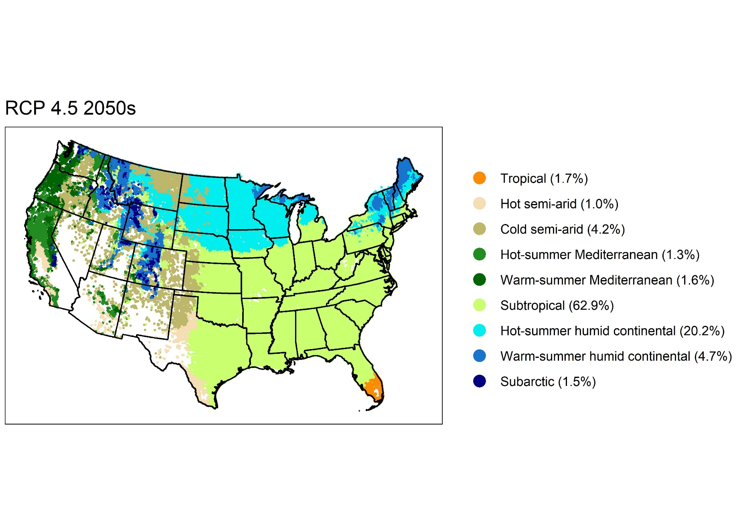

Slide 13
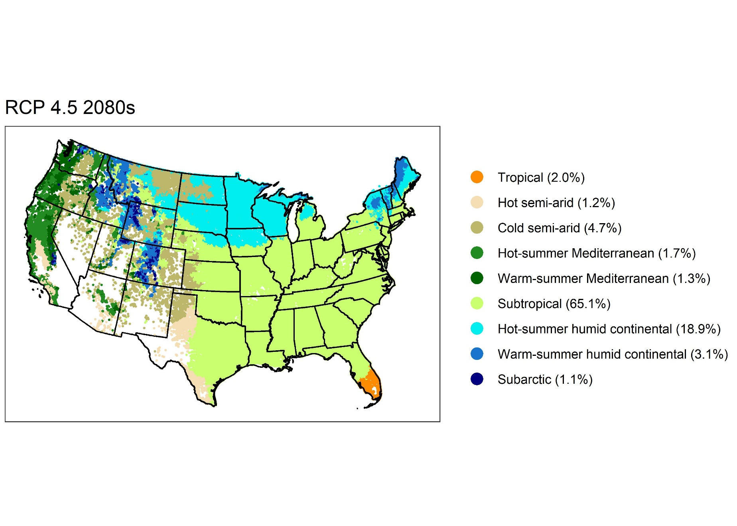

Slide 14


Slide 15
